Slide 1

B.Tech External Project Evaluation ,VIIth Sem
TuneTalk: Fusion of Music and Integrated Voice Communication
Presented by :
Viney Chillar (2021511307) Shivam Dhunotiya (2021003129)
Omama Beg (2021513778)
Under the Supervision of:-
Mr. Mohammad Asim
Assistant Professor
DEPARTMENT OF COMPUTER SCIENCE & ENGINEERING
SHARDA SCHOOL OF ENGINEERING AND TECHNOLOGY
November, 2024

Slide 2

Agenda
Introduction
Motivation
Problem Statement
Literature Survey
Research Gap
Objectives
Market Gap and Opportunity
Core Features and Functionalities
Technology Stack
UseCases and User Scenarios
Project Planning
Outcome
Conclusion

Slide 3
Progress
Evaluation 0: Title Approval Evaluation 1: Technical Feasibility Study , Conceptualization and Planning , Research and Market Analysis
Evaluation 2: Technology to be used, UseCases and User Scenarios

Slide 4

Introduction
TuneTalk is a revolutionary platform that seamlessly blends the worlds of music streaming and integrated voice communication.
By combining these two essential features, TuneTalk enhances user experience by providing a one-stop solution for both entertainment and communication needs.
Instead of toggling between different apps .TuneTalk allows users to effortlessly switch between listening to music and talking over voice call without interrupting their flow

Slide 5
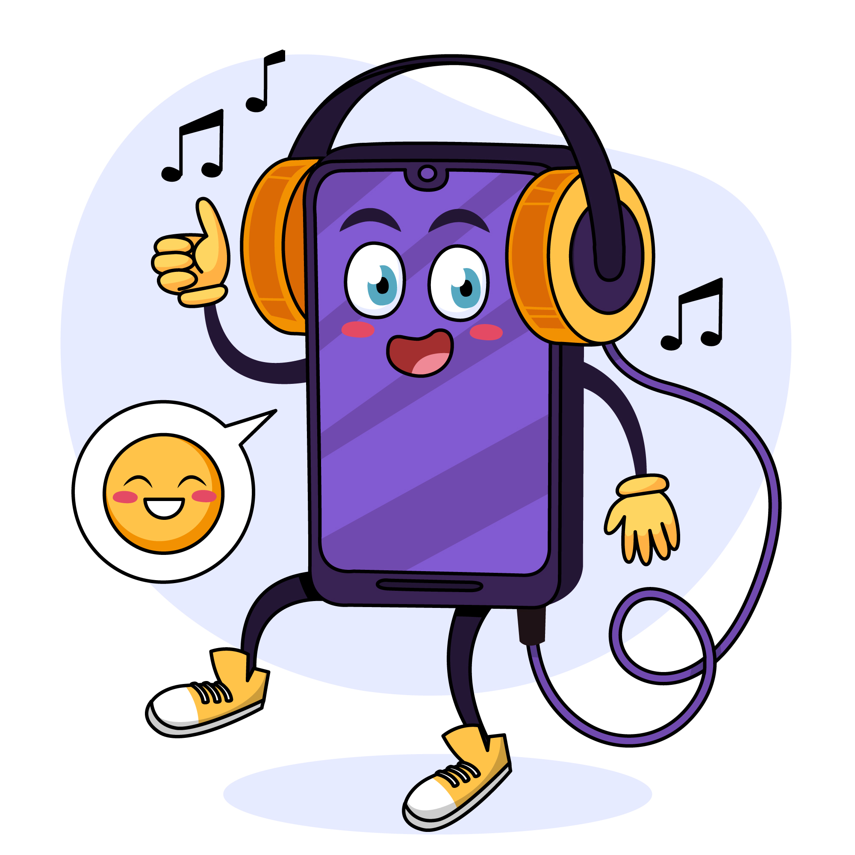
Motivation
After Resso was banned, there weren't any appealing alternatives. Spotify, although available, charged for its services and didn't offer as many features. It was this lack of satisfactory options that motivated us to embark on this project
So, we decided to incorporate features from Resso, some from Spotify, and others from different apps into our project.
Stay connected with loved ones while enjoying your favorite music.
Save time and effort by using one platform for both music and communication needs.

Slide 6
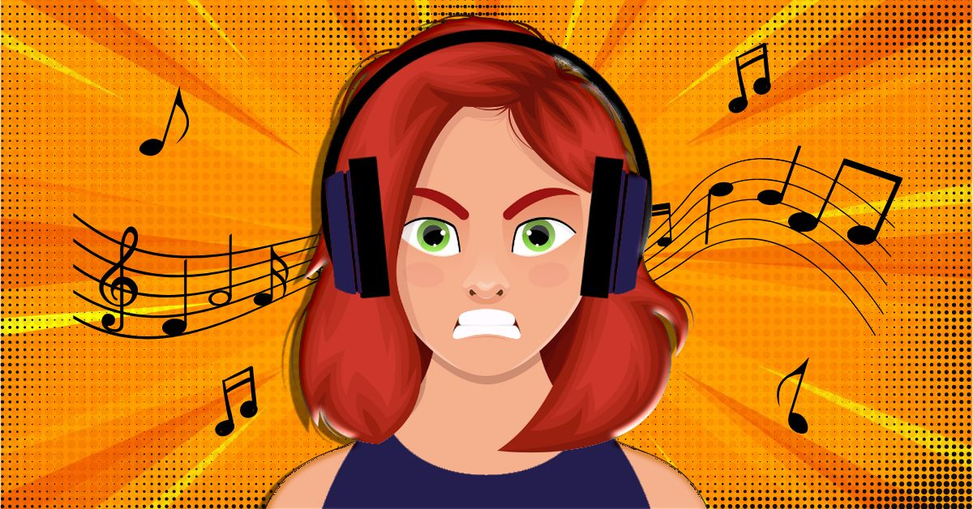
Problem Statement:
After Resso was banned, we found that there weren't any appealing alternatives. Spotify, while available, charged for its services and lacked certain features.
There is no platform that combines voice-based interaction with music sharing in a seamless, interactive manner.
The issue arose from the fact that people desired to chat and listen to music simultaneously, rather than switching between apps.
Additionally, if they wanted to change the song, they had to call or message, disrupting the experience.
Furthermore, existing apps automatically paused songs when making calls, making it challenging to use them effectively

Slide 7
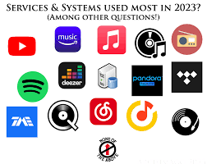
Literature Survey
Based on our review of existing music streaming and communication platforms these are the apps used:
Spotify's Superior Recommendation System: Spotify stands out for its advanced song recommendation algorithms, which attract users seeking personalized music suggestions tailored to their tastes. Additionally, its premium users can create virtual rooms for group listening experiences, addressing the need for social interaction while enjoying music.
Apple Music's 3D Head Tracking Technology: Apple Music offers innovative features such as 3D head tracking, enhancing the immersive experience for users who value high-quality audio and advanced technologies.
Gaana Music's HD Streaming: Gaana Music distinguishes itself by providing music streaming in HD quality, appealing to users who prioritize audio fidelity and superior sound reproduction.
Amazon Prime Music's Extensive Library: Amazon Prime Music boasts a vast collection of songs, leveraging the popularity and convenience of Amazon Prime memberships to attract users looking for a comprehensive music streaming service.
YouTube Music's Broad Content Availability: YouTube Music benefits from its extensive library, with virtually every song being available and released on the platform. Its robust recommendation system further enhances the user experience by suggesting relevant content based on individual preferences.

Slide 8

Research Gap
Spotify: Enhanced Control in Hosted Rooms: Investigate methods to provide more control to hosts in Spotify's hosted rooms, allowing for better management of interactions and content within the room.
Apple Music: Smart Playlist/Filtering System: Explore the development of a smart playlist and filtering system for Apple Music to facilitate efficient organization and navigation within users' music libraries.
Gaana Music: Improving Discoverability and Navigation: Conduct research to address issues of discoverability and clutter on Gaana Music's home screen, aiming to enhance user experience through improved content organization and navigation.
Amazon Music:Enhanced Streaming Quality: Investigate methods to improve Amazon Music's streaming quality, particularly in delivering HD audio streaming to enhance the overall listening experience for users.
YouTube Music: Background Play Feature: Research the implementation of a background play feature for songs on YouTube Music, addressing user demand for continuous music playback while using other applications or when the screen is turned off.
By focusing on these specific research gaps for each platform type, developers and researchers can work towards improving the respective platforms and addressing the needs and preferences of users.

Slide 9
Market Gap and Opportunity
Current platforms like Spotify focus heavily on music streaming but lack robust social interaction features.
Apps like Discord provide voice chat but are not built around music discovery and sharing.
TuneTalk combines the best aspects of both worlds—music discovery and social engagement—by allowing users to seamlessly switch between voice chats and music sharing, enabling personalized and social experiences.

Slide 10
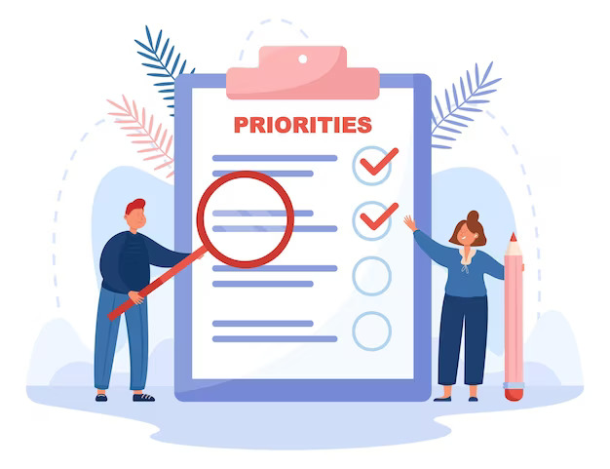
Objectives
Eliminate the need for users to switch between multiple apps by offering integrated music streaming and voice communication features into a unified platform.
Enhance user experience by providing
a extra additional volume beside the phone volume
audio quality and sound effect(bass booster,best fit,vocal booster)
lyrics and when displayed over other apps we can see lyrics is visible on the locked screen too

Slide 11
Core Features and Functionalities
TuneTalk allows users to create personalized playlists based on their listening habits, mood, and preferences.
Users can send snippets of songs (e.g., 30 seconds) to their friends for quick listening, allowing others to decide whether they want to explore the full track.
TuneTalk offers synchronization across multiple devices, ensuring users can seamlessly switch from their phone to their laptop or tablet without losing their place in the conversation or music playback.
Users can participate in music-based challenges, such as guessing the song from a short snippet or identifying artists from their albums. Points or rewards can be earned for correct guesses, and leaderboards can track performance.
Advanced audio effects such as smooth crossfades or transitions between songs in playlists, providing a DJ-like experience where songs blend seamlessly.

Slide 12
Technology Stack
Front-end Technologies - Frameworks (React.js)
-Tailwind CSS or Styled Components
- Redux or React Context API (for managing global state -> user sessions, playlists, and settings.)
- Socket.IO
- Axios or Fetch API(API requests for fetching music data, recommendations, user preferences)
Back-end Technologies - Node.js with Express.js(multiple connections, such as real-time chat and voice communication.)
- Socket.IO
- Flask/Django( for mood detection, music recommendations)
- TensorFlow or PyTorch(For training and deploying machine learning models).

Slide 13
Technology Stack
Database and Data Storage
-PostgreSQL(to store user data, playlists, listening history, chat logs)
- MongoDB(store real-time, unstructured data, such as chat messages, user activity logs, and real-time playlist collaborations.)
- Redis(For caching frequently accessed data, such as user playlists, recommendations, and recent search results, to improve performance and reduce database load.)
- Google Cloud Storage(For storing large media files such as song snippets, cover art, or user-generated content like voice notes and remixes)
Authentication and Security
- OAuth 2.0(for secure user login and third-party API integrations)
- for encryption JWT (JSON Web Tokens) – (For secure authentication and maintaining user sessions)
- End-to-End Encryption

Slide 14
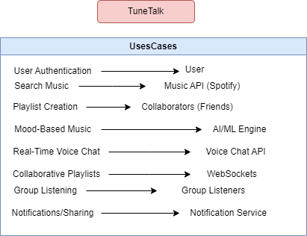
UseCases and User Scenarios
User Authentication
Description: Users can sign up, log in, or log out of TuneTalk.
Actors: User, OAuth 2.0 Service (Google/Spotify)
Preconditions: The user must have an account or can sign up using an OAuth provider.
Steps:
User opens the TuneTalk app/web.
User selects to log in using Google/Spotify or creates a new account.
The system authenticates the user using OAuth or JWT.
User is redirected to the home page upon successful authentication.
Postconditions: User is authenticated and granted access to their dashboard.
2. Search and Discover Music
Actors: User, Music API (Spotify/YouTube)
Preconditions: The user is logged in.
Steps:
User types a query or uses a voice command to search for a song or artist.
The system fetches the results from the Music API (e.g., Spotify API).
The system also generates recommendations based on the user’s history or mood.
User selects a track from the results to play.
Postconditions: Music starts playing, and related music suggestions are shown.
Description: Users can search for music or discover new tracks through recommendations.

Slide 15
3. Playlist Creation and Sharing
Description: Users can create, modify, and share playlists with friends.
Actors: User, Friends (other users)
Preconditions: User is logged in, and they have songs added to the playlist.
Steps:
User creates a new playlist by selecting songs.
User can invite friends to collaborate on the playlist via chat or direct sharing.
Friends can add or edit songs in the shared playlist.
Postconditions: The playlist is collaboratively managed and updated by multiple users.
4. Mood-Based Music Recommendation
Description: Users can get personalized recommendations based on their mood.
Actors: User, AI/ML Model
Preconditions: The user has a listening history or has provided input (chat/voice).
Steps:
The system detects the user’s mood through voice command or text chat sentiment.
Based on the detected mood, the system recommends songs/playlists.
The user can play the recommended tracks or refine the recommendations.
Postconditions: The user listens to a playlist that matches their current mood.

Slide 16
5. Real-Time Voice Chat
Description: Users can engage in voice conversations with friends while listening to music.
Actors: User, Friend(s)
Preconditions: Users must be online, and WebSocket/RTC is enabled.
Steps:
User invites a friend to a voice chat while a song is playing.
System establishes a WebRTC connection between users for real-time audio communication.
Users can talk while listening to synchronized music.
Users can leave the chat or mute the music without ending the voice session.
Postconditions: Real-time voice chat ends when users disconnect.
6. Real-Time Collaborative Playlist Editing
Description: Users can collaboratively add, delete, or reorder songs in a playlist in real-time.
Actors: User, Collaborators
Preconditions: The user has shared a playlist with others.
Steps:
Collaborators can add, remove, or rearrange songs in real time.
All collaborators see the changes instantly (using WebSocket for real-time updates).
User initiates collaboration by sharing a playlist link or inviting others via chat.
Postconditions: Playlist is updated in real time, and all changes are synchronized.

Slide 17
7. Real-Time Group Listening
Description: Users can synchronize music playback with friends in real time.
Actors: User, Friends (other users)
Preconditions: Users must be logged in, and their friends must be available.
Steps:
User initiates a group listening session by inviting friends.
System synchronizes music playback across all connected users.
Users can chat or voice chat while the music is playing.
Postconditions: All users listen to the same track at the same time.
8. Notifications and Social Sharing
Description: Users receive notifications about music, playlist updates, or friend activities.
Actors: User, Notification Service
Preconditions: User must be logged in and have notifications enabled.
Steps:
User receives a notification when a friend shares a playlist or song.
System sends real-time notifications when friends are online or join a group session.
Users can directly share songs via social platforms (Facebook, Twitter).
Postconditions: Notifications are displayed, and users can interact with them.

Slide 18
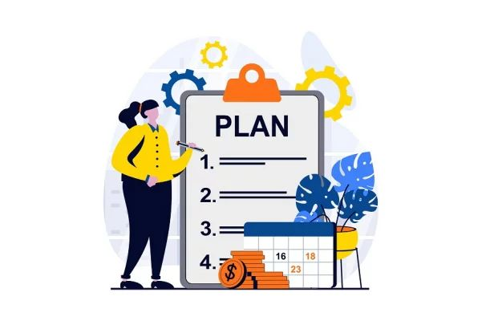
Project Planning
Phase 1: Planning and Requirements Gathering
Duration: April 2024
Tasks: Define project scope, identify requirements, and finalize project plan.
Deadline: End of April 2024
Phase 2: Design and Conceptualization
Duration: May - August 2024
Tasks: Develop wireframes and prototypes,Design user experience, Define feature set including volume controls, audio quality settings, and synchronized lyrics display.and conduct iterative testing.
Milestones: Prototype development (May 2024).
Deadline: End of August 2024

Slide 19

Project Planning
Phase 3: Development and Implementation
Duration: September - October 2024
Tasks: Build the backend infrastructure,Develop frontend components,gather user feedback, andIntegrate third-party APIs for music catalog, lyrics database, and voice communication functionalities.
Milestones: Full deployment (September 2024).
Deadline: End of October 2024
Phase 4: Testing and Quality Assurance & Deployment and Launch
Duration: November - December 2024
Tasks: functional testing,usability testing,Develop marketing and promotional materials,Monitor user feedback and analytics.
Deadline: Ongoing maintenance post-launch.

Slide 20
Outcome
Paper Acceptance:
Research paper successfully accepted for publication at Manav Rachna Conference 2024.
Registration process completed and presentation preparation underway.
Implementation Status:
Core functionalities implemented successfully.
System undergoing final testing with promising results.
Progress Highlights:
Seamless integration of music streaming and voice communication achieved.
Strong performance metrics and positive user feedback received.
Next Steps:
Final optimizations and integration of new ideas.
Preparing for live demo and feedback at the conference.

Slide 21

Conclusion
TuneTalk aims to address the challenge of switching between multiple apps for communication and music streaming, TuneTalk simplifies the user experience and eliminates the hassle of toggling between different platforms.
Our solution offers a seamless and intuitive interface that enhances user convenience and satisfaction in the digital landscape

